Slide 1
HOTEL PLAZA Assignment
By BOAGROUP

Slide 2



BUSINESS

Slide 3
GANTT chart

Slide 4
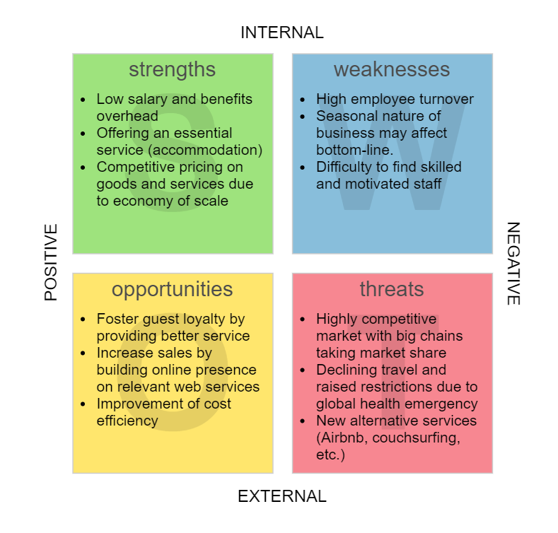

Slide 5
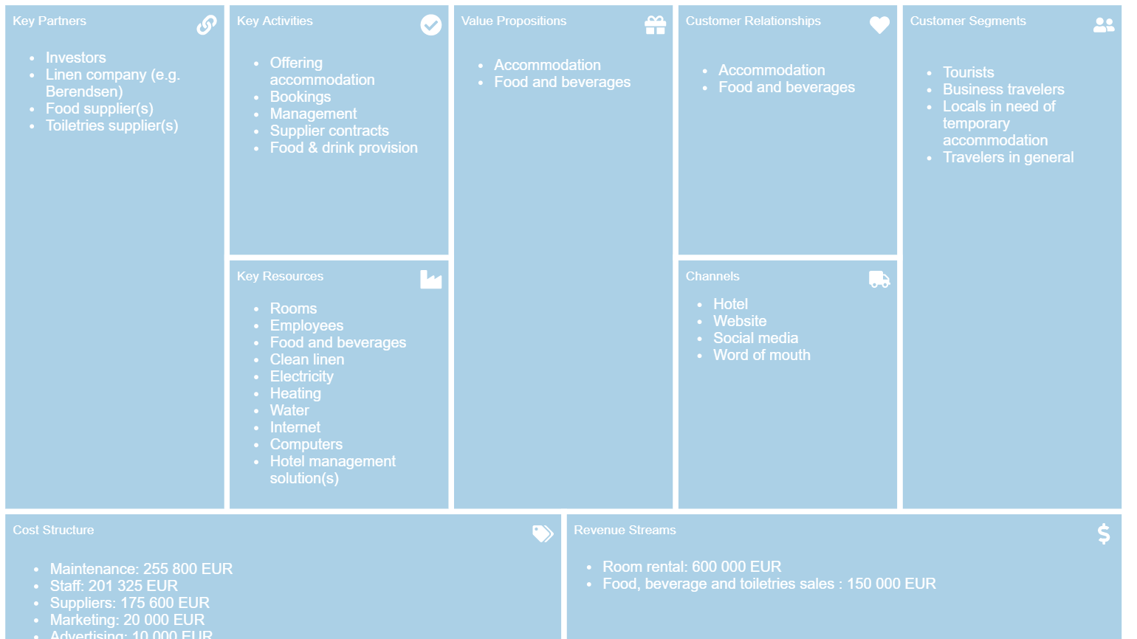

Slide 6
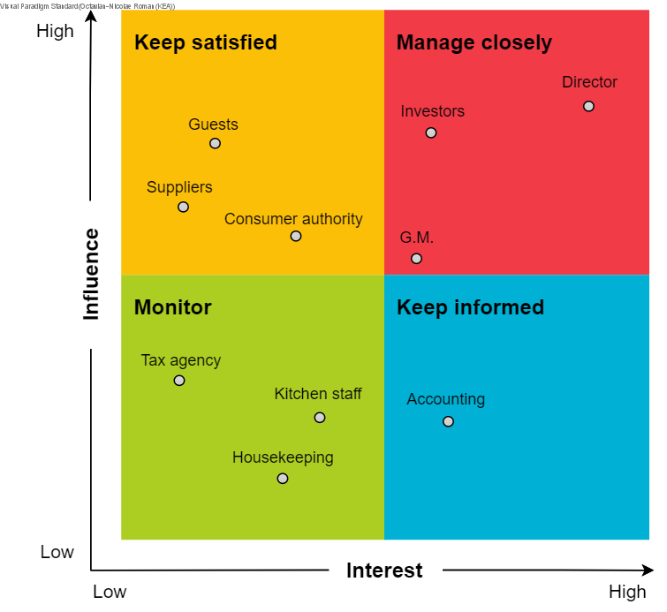

Slide 7

SOFTWARE DEVELOPMENT

Slide 8
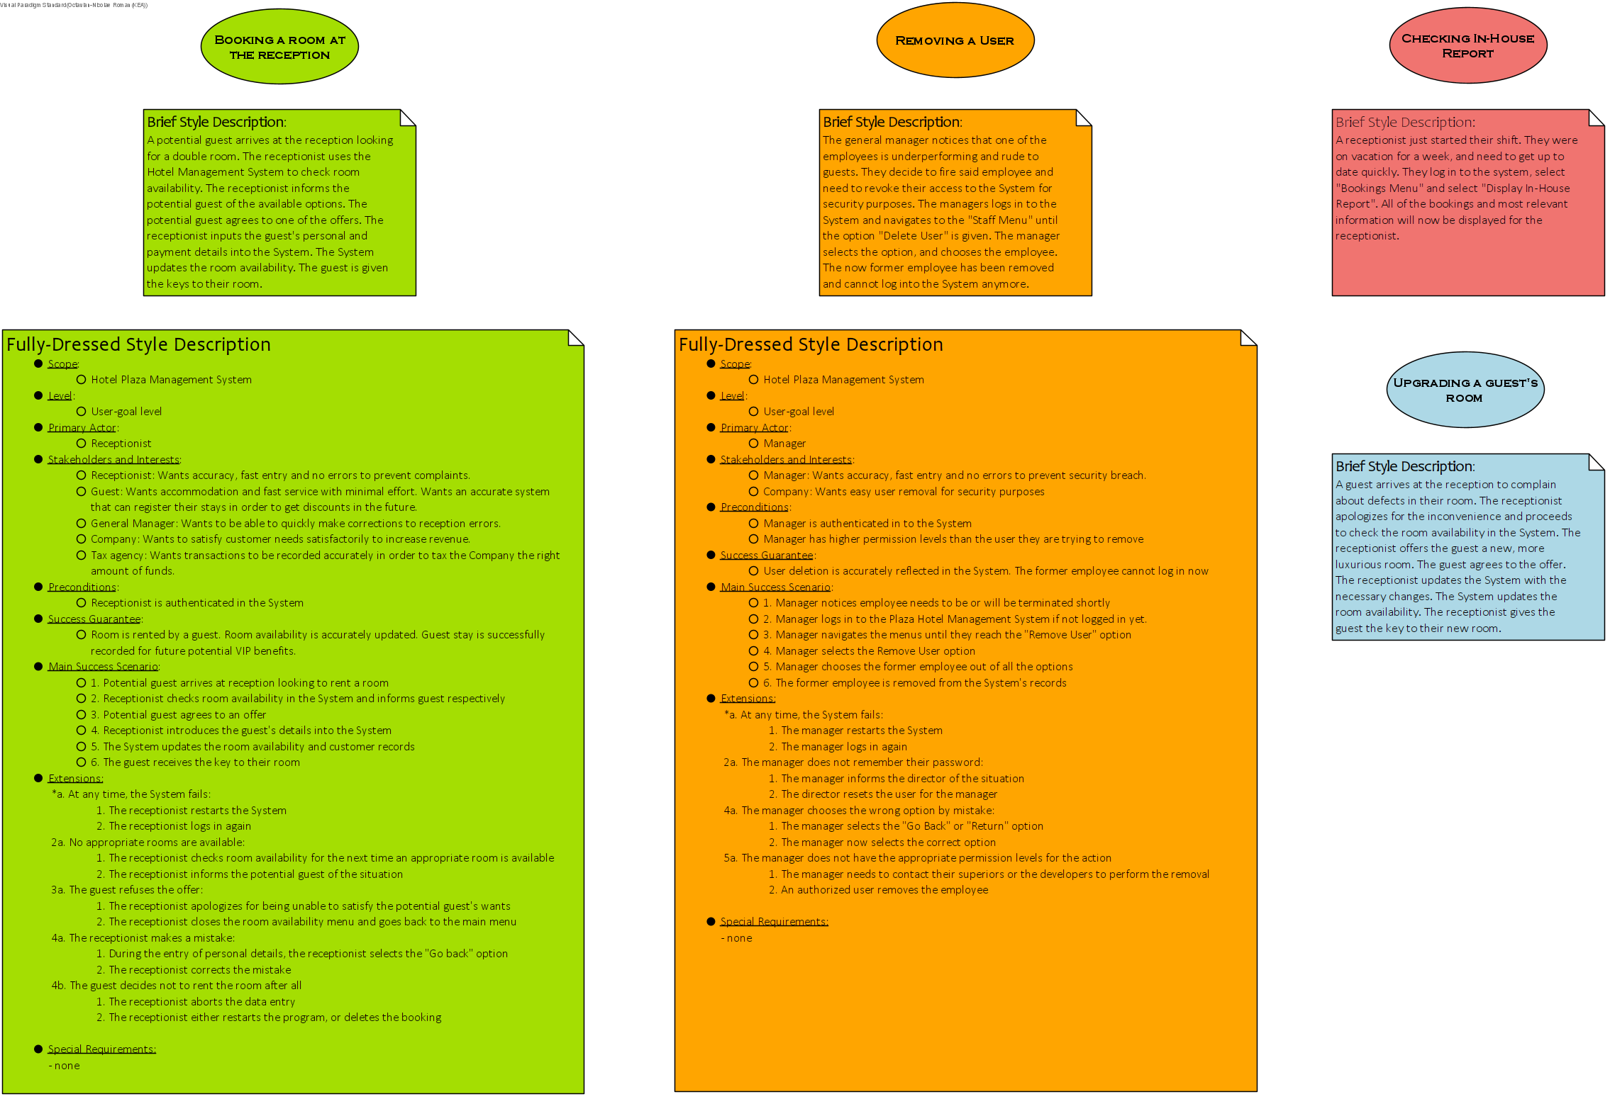

Slide 9
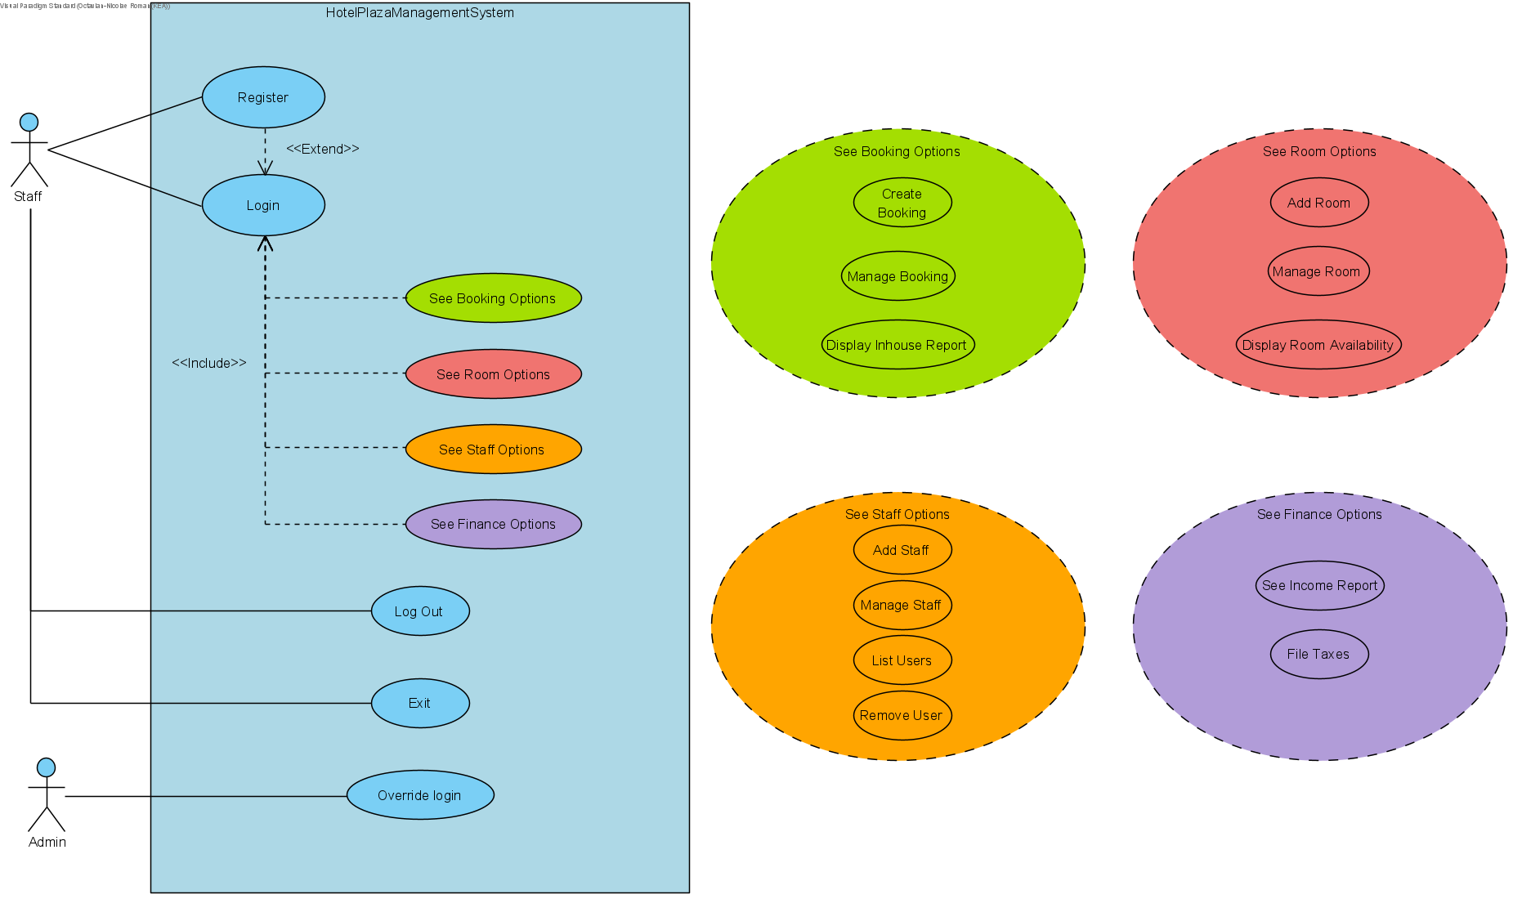

Slide 10
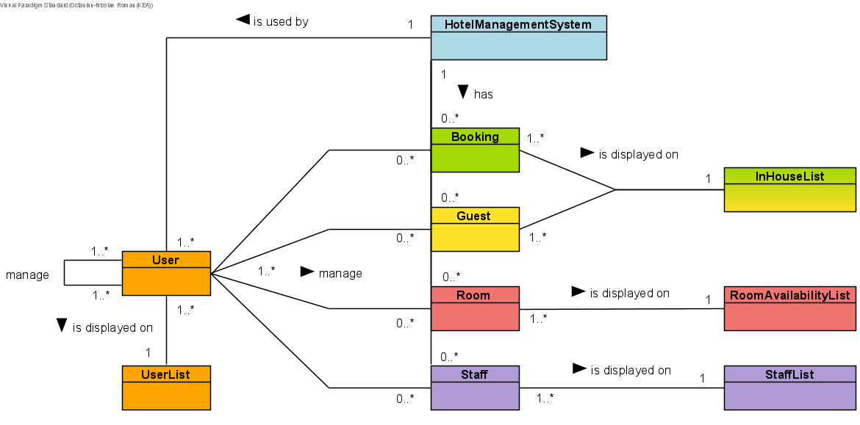

Slide 11
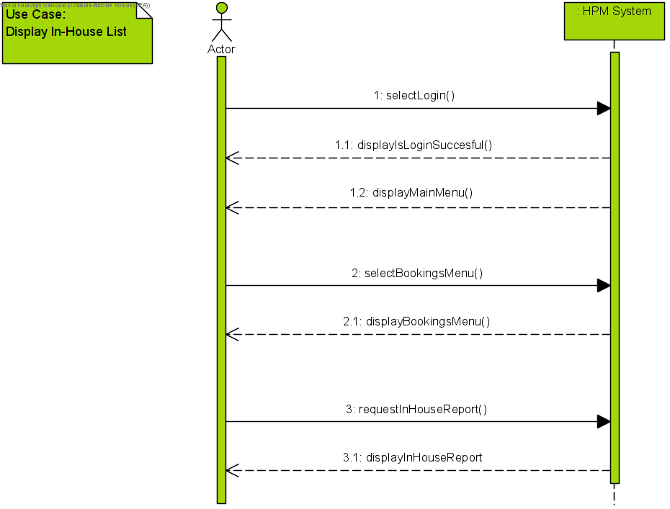
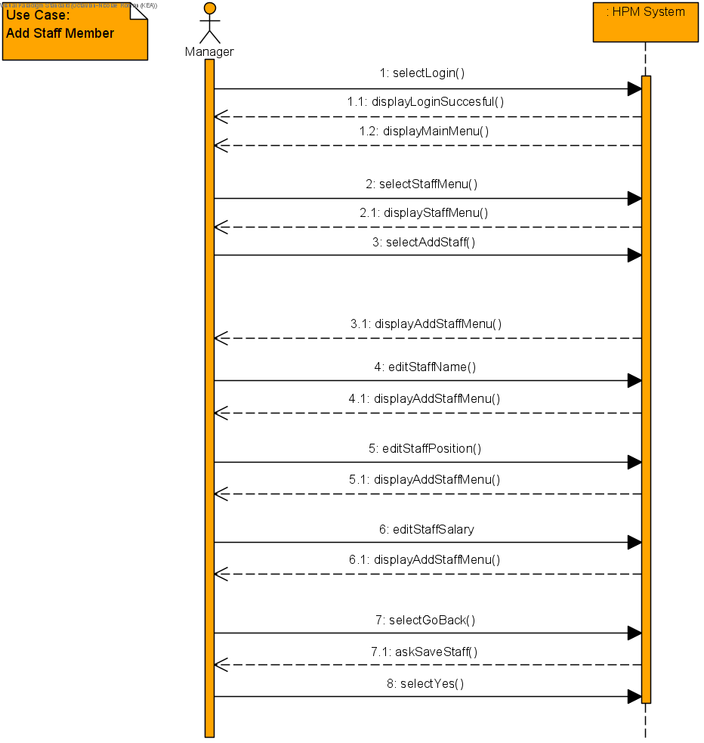
HOTEL PLAZA by boagroup

Slide 12
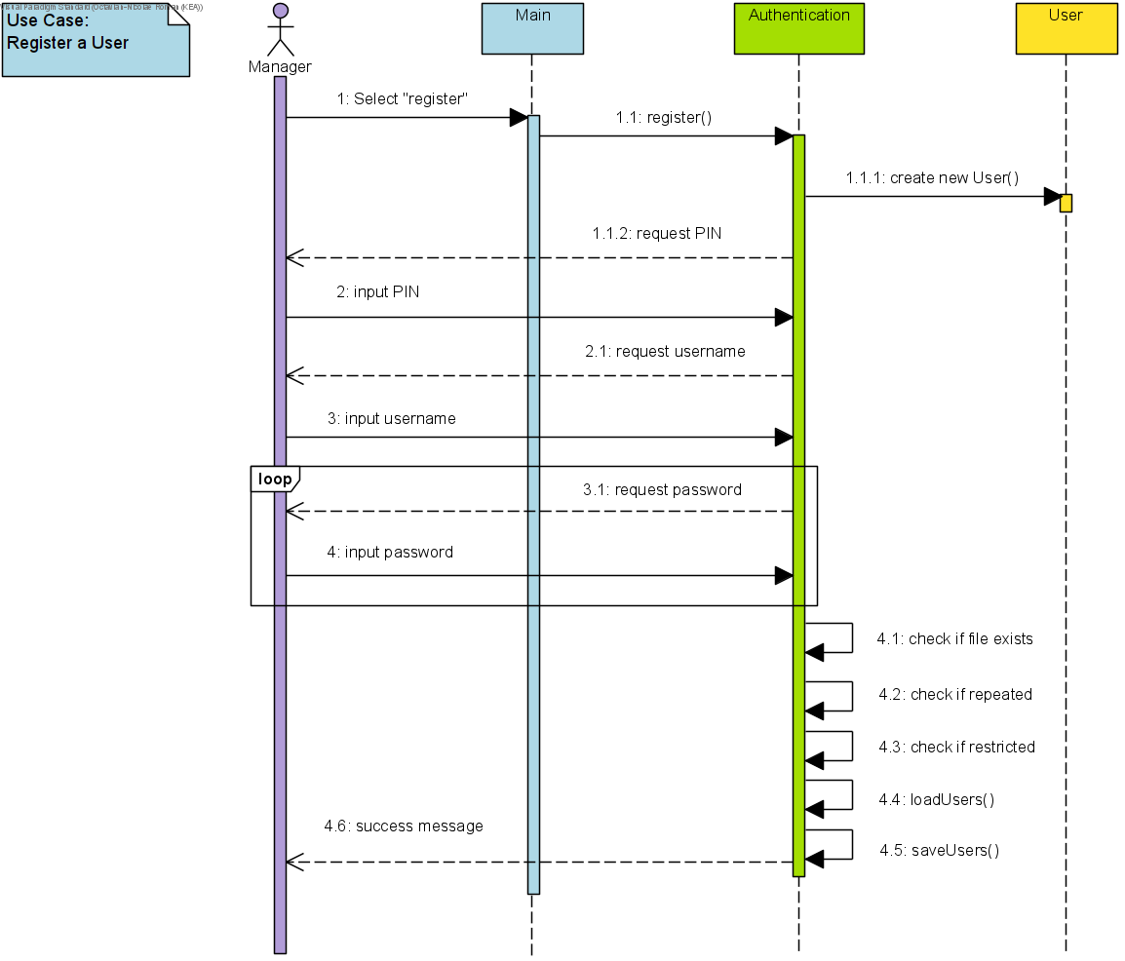

Slide 13
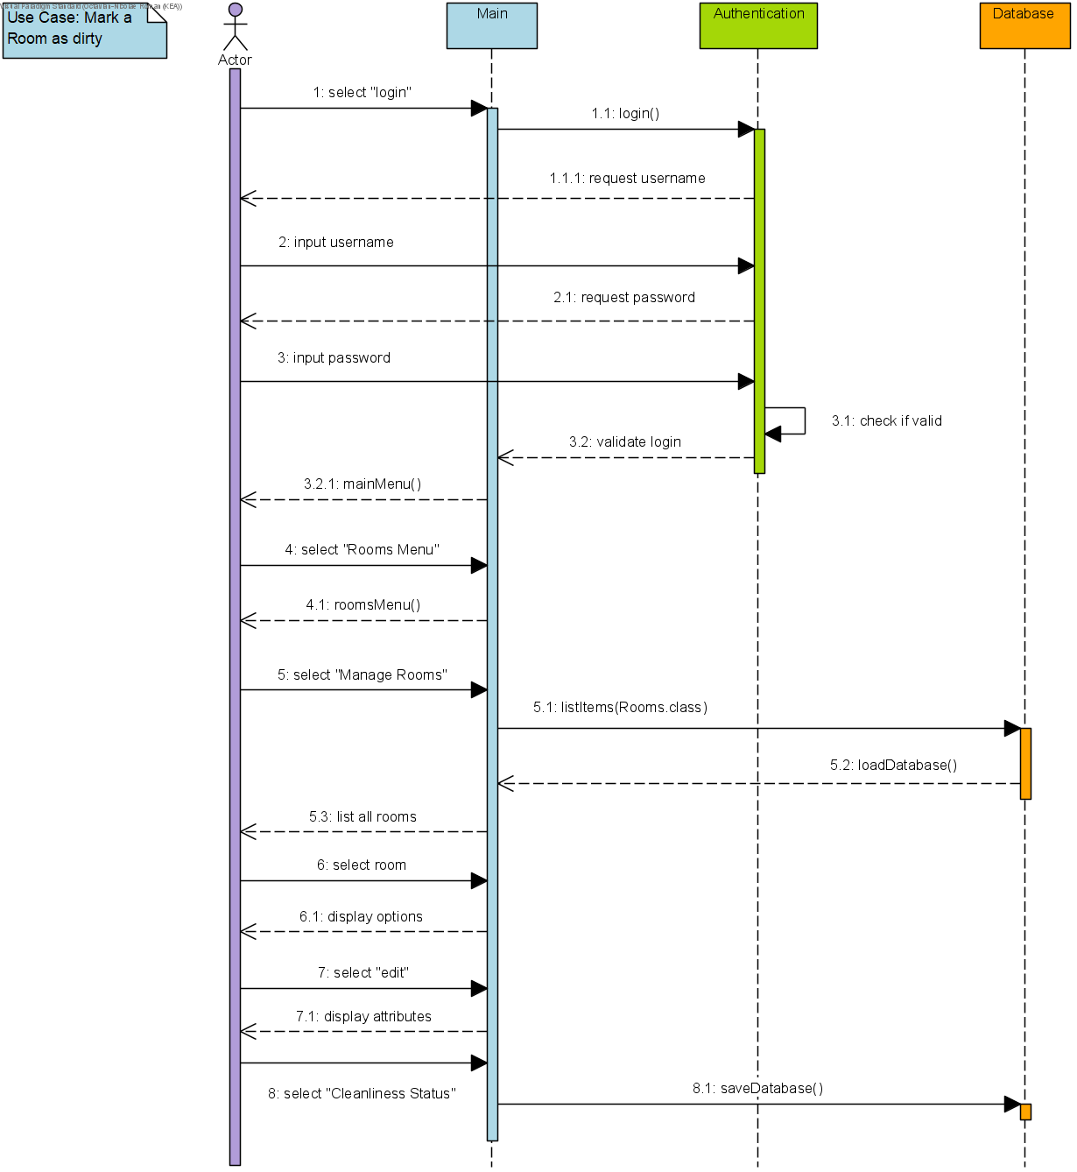

Slide 14
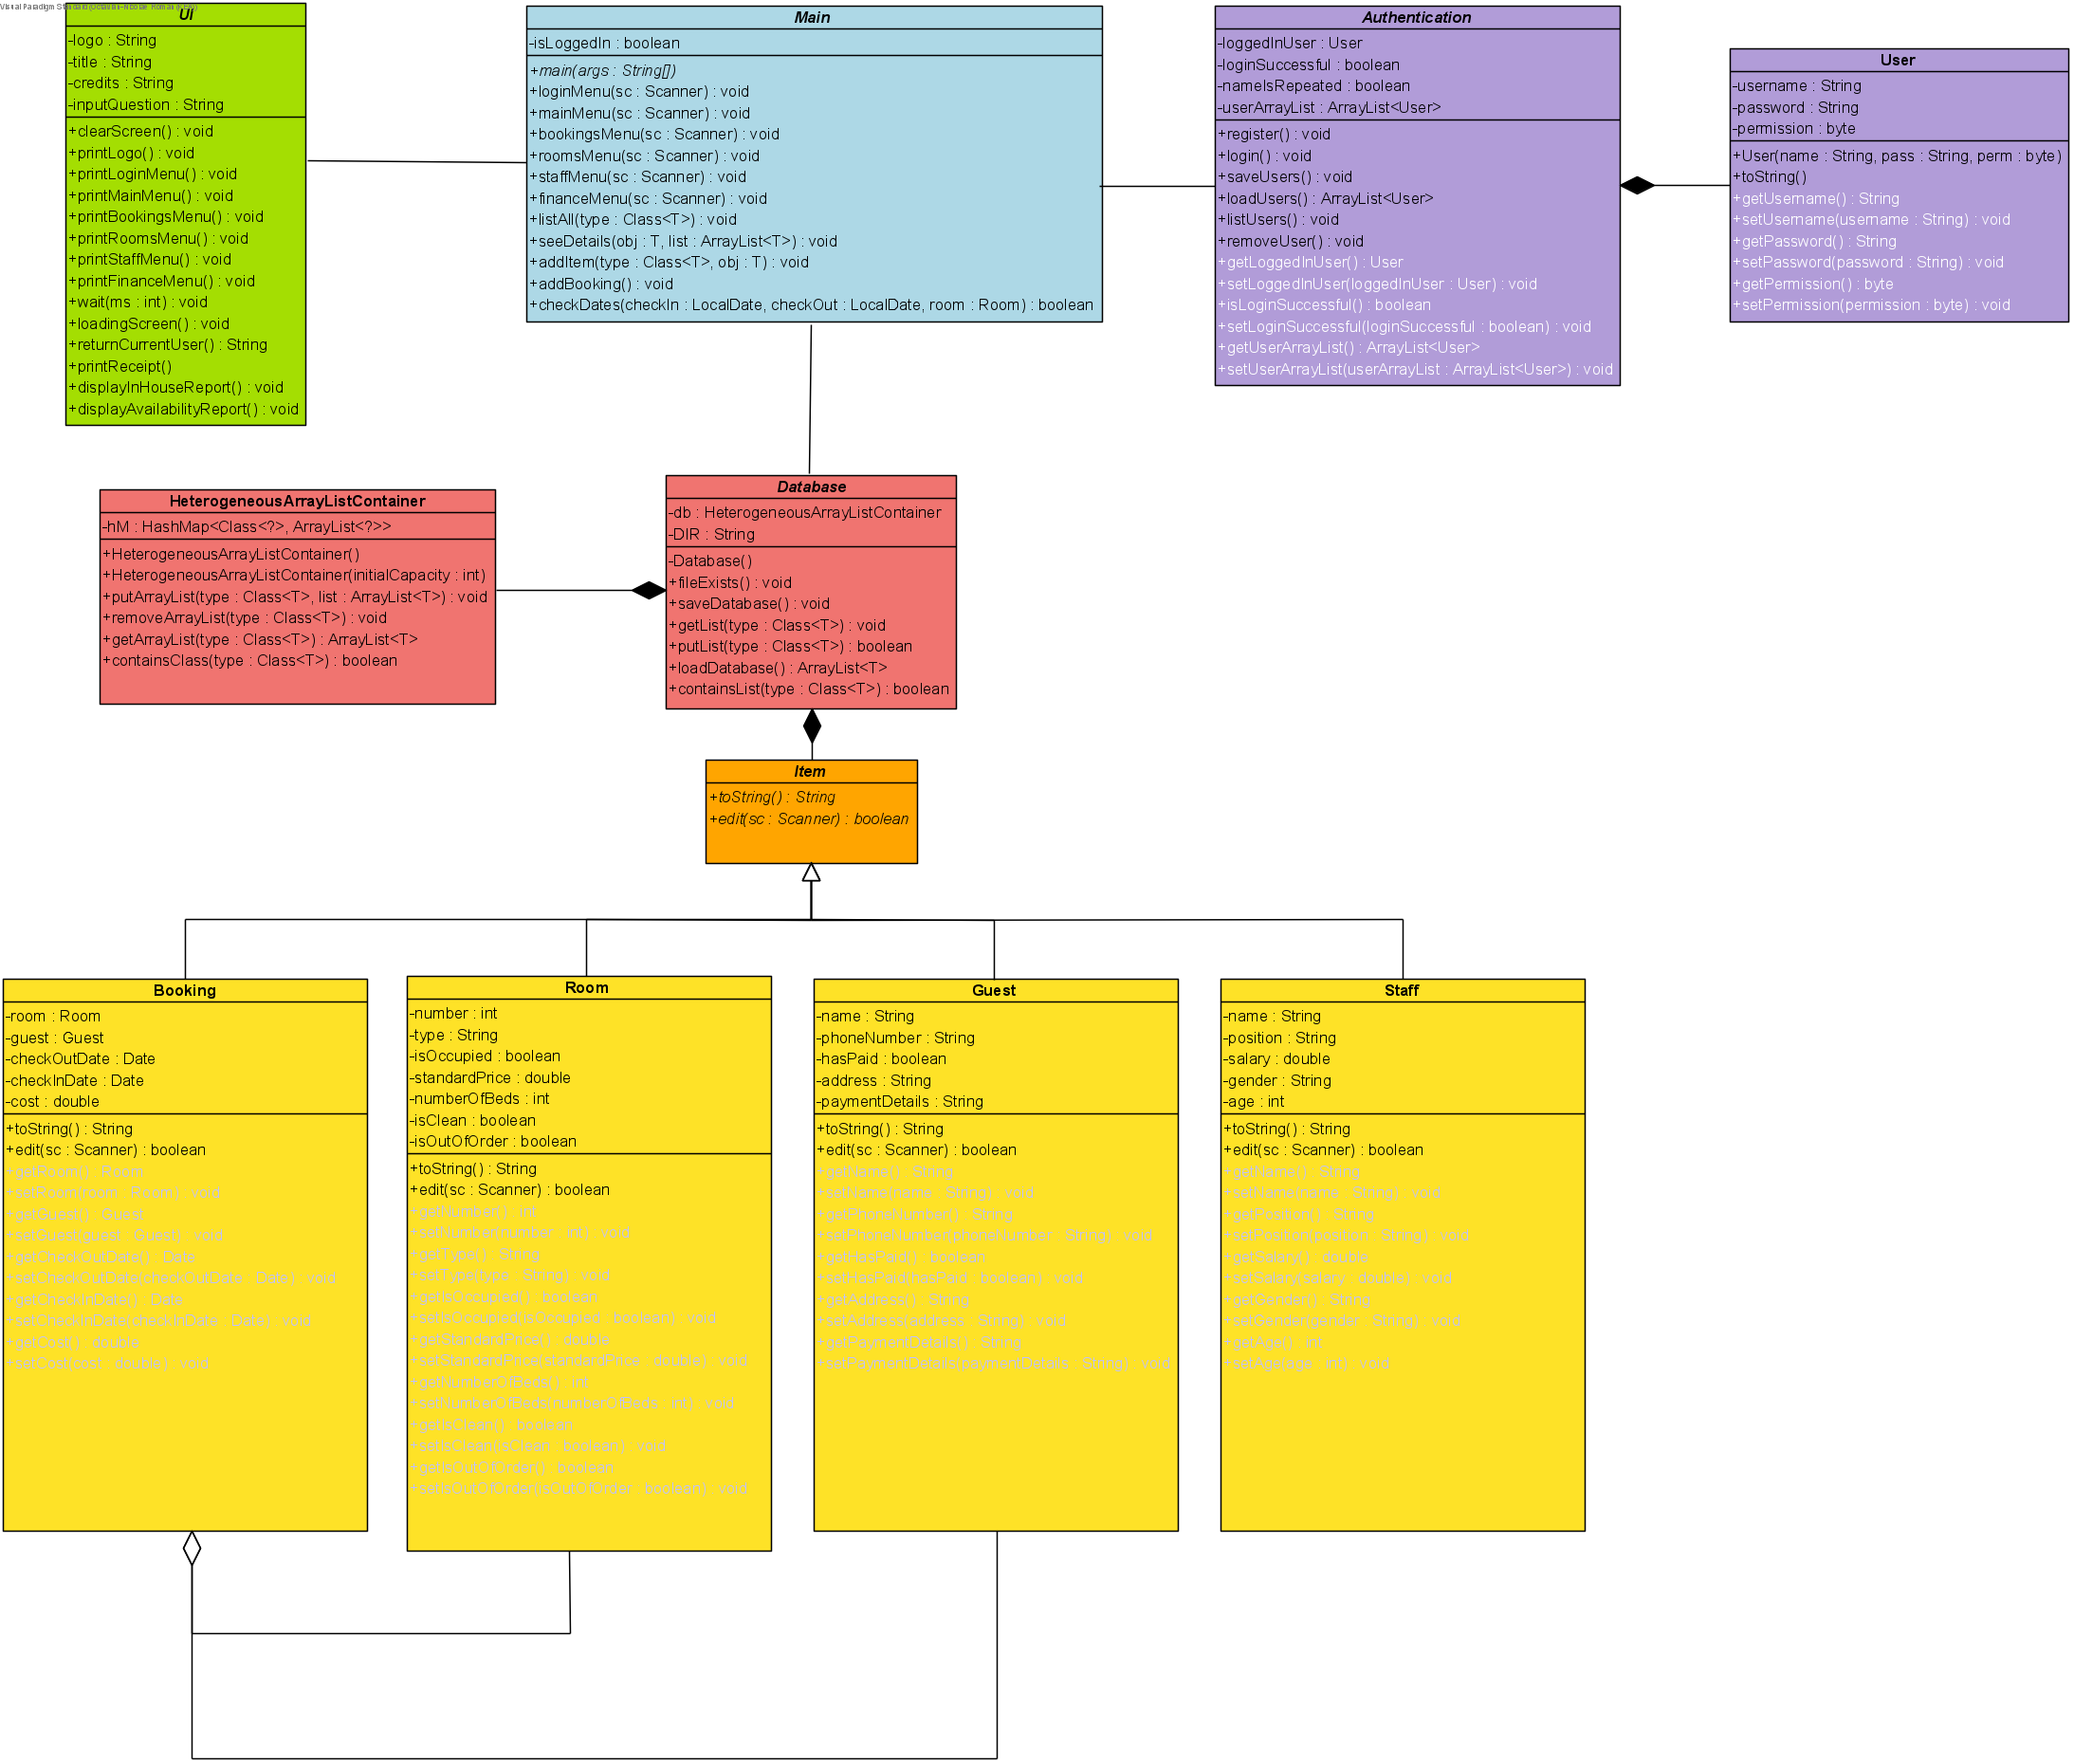

Slide 15

And now… Time to run the program!

Slide 16
THE END

